Slide 1

The Arzens
cybersecurity foundations and Professional Readiness
Security Testing Report

Slide 2
Submitted By:
Name: Mahnoor Shuaib
Reference Code: ARZ-2026-YJJW
Internship Track: Cyber Security foundations and Professional Readiness

Slide 3
Finding 1:
Issue in Ambassador Registration Form
Issue Title: Improper Input Validation – Ambassador Registration Form (Multiple Fields)
Affected Page/Feature: Ambassador Registration Form (University Name, City, Department, Semester fields)

Slide 4
Steps to Reproduce:
Navigate to the Ambassador registration form on the website.
Fill in the Name and Email fields with valid data.
In the University Name field, enter numeric characters instead of a valid university name (e.g., 12345).
In the City field, enter numeric characters instead of a valid city name (e.g., 12345).
In the Department field, enter numeric characters instead of a valid department name (e.g., 12345).
In the Semester field, enter an invalid value such as a negative number (e.g., -5) or an out-of-range number (e.g., 12345).
Submit the form.

Slide 5
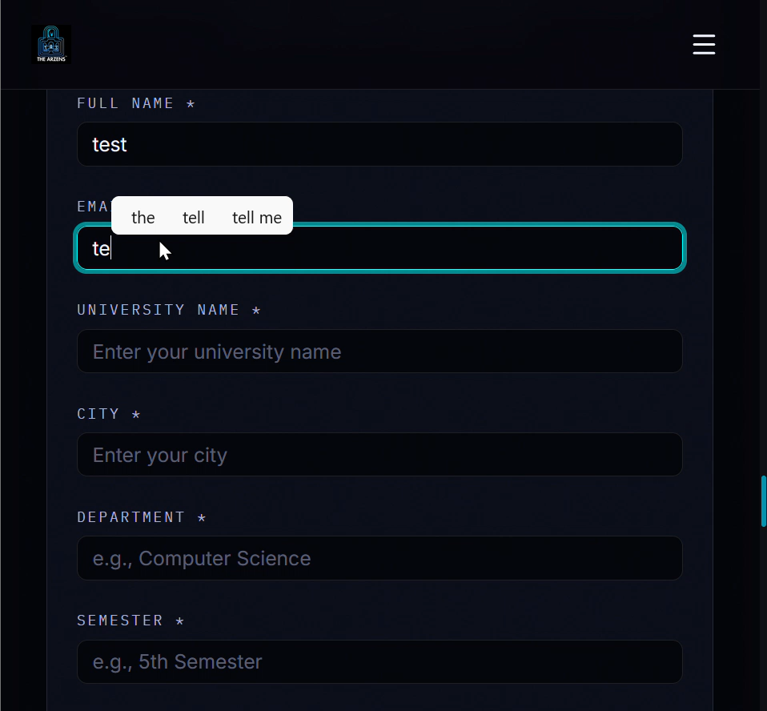
Video recording:

Slide 6
Expected Result: The form should validate each field according to its expected data type (e.g., text-only for University Name, City, and Department; a valid numeric range such as 1–8 for Semester) and reject the submission with an appropriate error message if invalid data is entered.

Slide 7
Actual Result: The form accepted numeric input in all text-based fields (University Name, City, Department) and accepted illogical/out-of-range values in the Semester field (e.g., negative numbers, out-of-range numbers).
The application was submitted successfully in every case without any client-side or server-side validation error.

Slide 8
Severity/Impact: Low (🔵)
Allows storage of illogical and inconsistent data in the backend database, affecting data integrity. Indicates a likely absence of server-side input validation across the form. Could allow automated bots or malicious users to flood the database with junk/fake registrations.

Slide 9
Recommended Solution:
Implement server-side input validation for all form fields, not just client-side (JavaScript) checks, since client-side validation can be bypassed.
Restrict the Semester field to a defined numeric range (e.g., dropdown selection of 1–8, or numeric min/max validation).
Restrict University Name, City, and Department fields to alphabetic/text input patterns using regex validation, disallowing purely numeric entries.
Apply consistent validation rules across the entire form and return clear error messages when invalid data is submitted.

Slide 10
Finding 2:
Issue Title: Unrestricted File Upload
No File Extension/Type Validation on Resume Field

Slide 11
Finding 2:
Unrestricted File Upload, No File Extension/Type Validation on Resume Field

Slide 12
Affected Page/Feature: Ambassador Registration Form (Resume Upload field)
Steps to Reproduce:
Navigate to the Ambassador registration form.
Fill all required fields with valid data.
In the Resume upload field, select and upload a file with a non-document extension (e.g., a .py Python file) instead of the expected .pdf/.doc format.
Submit the form.

Slide 13
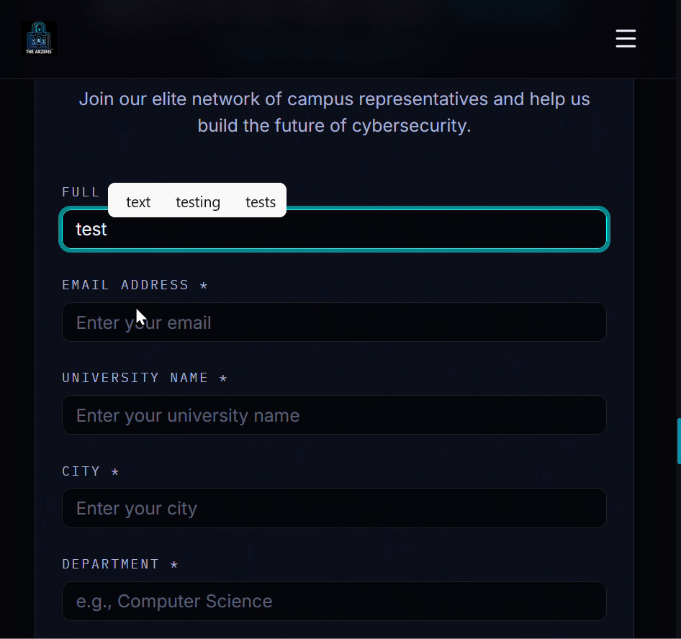
Video
Recording:

Slide 14
Expected Result: The system should validate the uploaded file's type/extension and reject any file that is not an approved document format (e.g., PDF, DOC, DOCX), returning a clear error message

Slide 15
Actual Result: The system accepted a .py (Python script) file in the Resume upload field without any restriction, and the application was submitted successfully.

Slide 16
Severity/Impact: Medium (🔵)
Lack of file type/extension validation on file uploads is a significant risk area: if the server does not also validate file content and storage handling, it could potentially allow upload of executable or script files, which depending on server configuration, may lead to remote code execution, server compromise, or defacement.
Even without further exploitation, this represents a meaningful gap in input validation that goes beyond simple data-integrity concerns, since uploaded files are typically stored and may be accessed/executed under certain server misconfigurations.

Slide 17
Recommended Solution:
Validate uploaded file types both by file extension and MIME type/file signature (magic bytes) — do not rely on extension alone, as it can be spoofed.
Restrict accepted file types strictly to expected formats (e.g., .pdf, .doc, .docx).
Store uploaded files outside the web root, or in a location where they cannot be directly executed by the server.
Rename uploaded files upon storage (e.g., using a generated ID) rather than preserving user-supplied file names.
Implement a maximum file size limit and scan uploaded files for malware where feasible.

